Slide 1
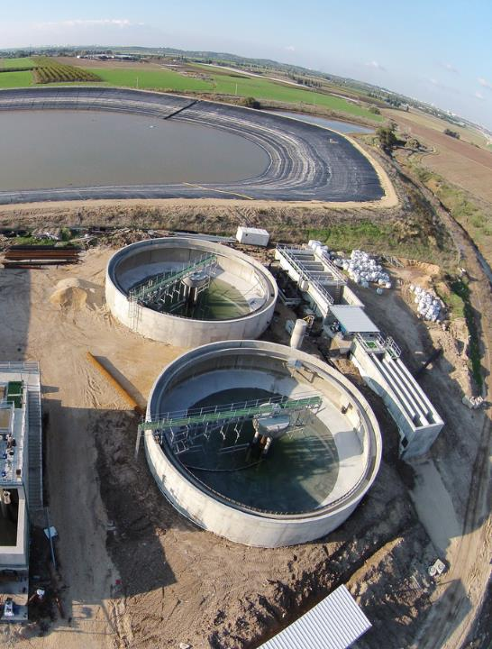

SHTANG WASTE WATER
SHTANG WATER
SHTANG ENERGY
SHTANG INFRASTRUCTURE
YOUR CHALLENGE IS OUR MISSION
WASTE WATER, WATER, ENERGY & INFRASTRUCTURE PROJECTS

Slide 2
WHO WE ARE
SHTANG is an Israel-based global company, specializing in complex and large scale projects
for government agencies, municipal authorities and private customers.
SHTANG covers all aspects of the project from initial planning and financing to
construction and maintenance.
SHTANG has hundreds of employees, most of them expert engineers
SHTANG was established in 1935 – over 80 years ago, as one of the first
companies in Israel
SHTANG merged with TGW in 2009 – The Green Way – the leading environmental group in
Israel, founded in 1997 by Harel Golst
SHTANG INTERNATIONAL is a partnership between TGW , SHTANG and Inver Brass – a private company
owned by Steven Senter who held key positions in global leading companies for 20 years

Slide 3
FIELDS OF EXPERTISE
WATER
ENERGY
INFRASTRUCTURE
O&M
Wastewater Treatment Plants
Water Treatment Plants
Irrigation
Pipe jacking
Sewage line restoration
Water Conveyance
Waste to Energy
Renewables
Co-Generation
Gas
Tunneling/Pipe jacking
Parks
Landscape
Environmental Engineering
Urbanization
Roads
  Municipalities
  WWTP
  Roads
  Parks
  Lighting, Electricity, Supervision
Click on subject to learn more

Slide 4
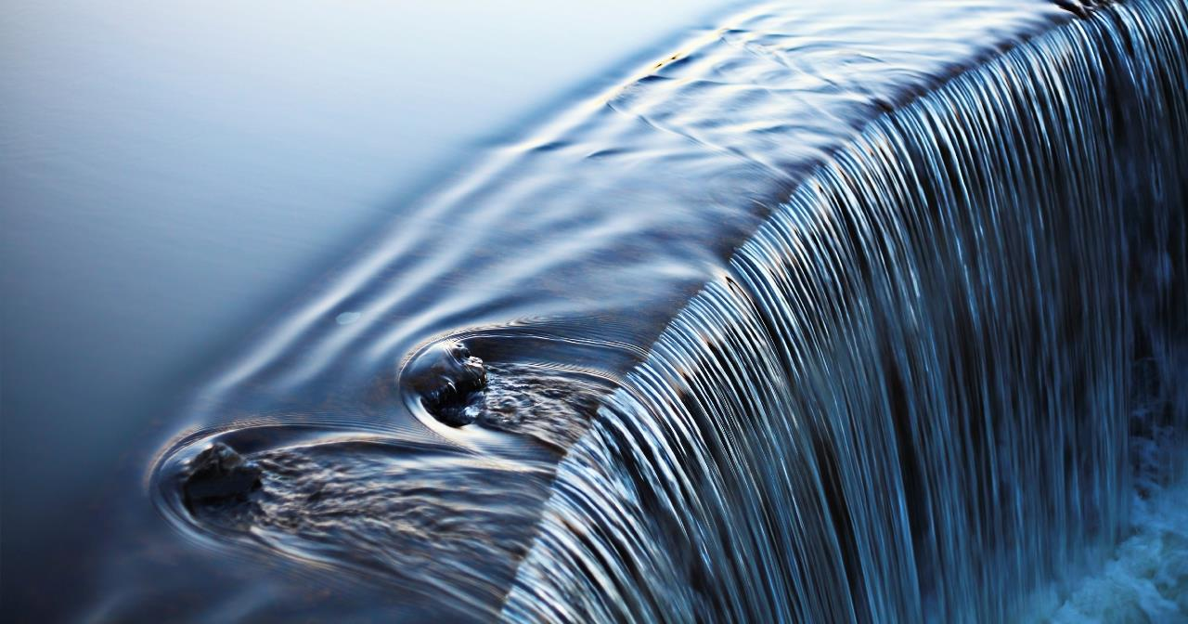
SHTANG WASTEWATER
SHTANG provides government entities, municipalities, local councils and the private sector state-of-the-art waste water treatment plants, tailoring the selected technology to each individual project.
Whether using Activated Sludge, SBR, MBR, MSBS and other cutting-edge technologies, we design, build, operate and maintain the most efficient solutions for wastewater treatment.
From small scale 700 m3/d ,using state of the art MSBS technology to plants treating hundreds of
thousands of m3/d using conventional activated sludge.
From plants using secondary /biological treatment only, to cutting edge tertiary treatment, resulting in high level effluent suitable for unlimited irrigation and discharge to rivers.
We construct pumping stations for waste water and sludge at all levels , from project management , design, engineering , installation, commissioning and maintenance .
SHTANG can take on any project , of any size, complexity and technology.

Slide 5
SHTANG WATER
Israeli expertise in water treatment, waste water treatment , reclaimed water and irrigation are famous worldwide. We harness this knowhow and manpower for your needs.
We constructed water projects starting from small local ones up to national, large scale and complex waste water and water treatment plants.
We constructed pumping stations for water at all levels , from project management , design, engineering , installation, commissioning and maintenance
We constructed reservoirs and storage tanks of all sizes – both fresh water gathered in winter to be used in summer and treated effluents to be used for irrigation and landscape
SHTANG possesses extensive experience in designing , implementing and maintaining smart and highly efficient landscape and irrigation systems. We will enhance any project’s profitability in a sustainable and ecological manner.

Slide 6
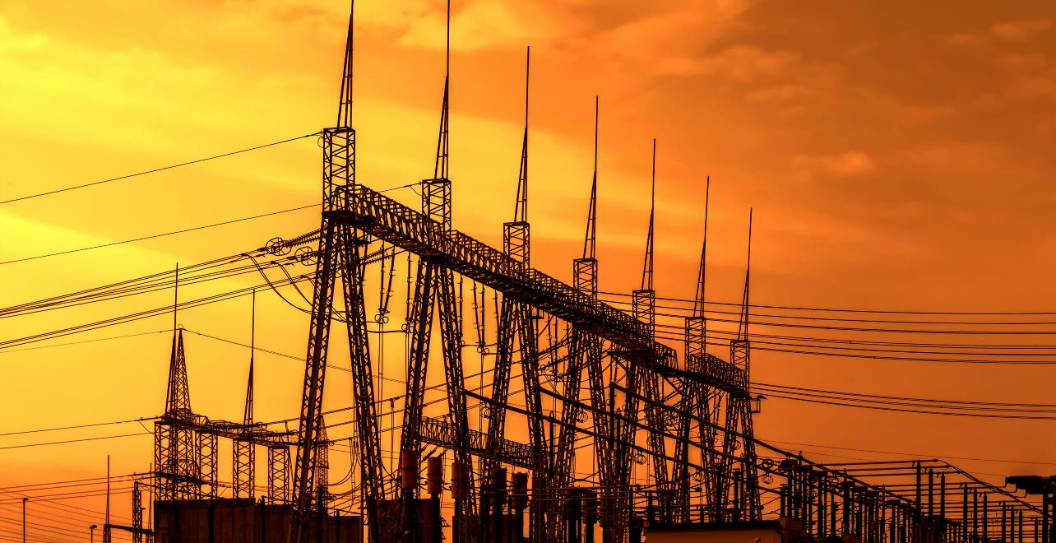
SHTANG ENERGY
SHTANG can design, plan and construct large scale Energy projects – from A to Z
SHTANG constructed the largest power plant in the Middle East based on biogas from sanitary sludge treatment
SHTANG was part of the national project of pumped storage hydroelectricity.
RENEWABLE ENERGY
  Photo-voltaic
  Waste to Energy
NATURAL GAS
CO – GENERATION

Slide 7
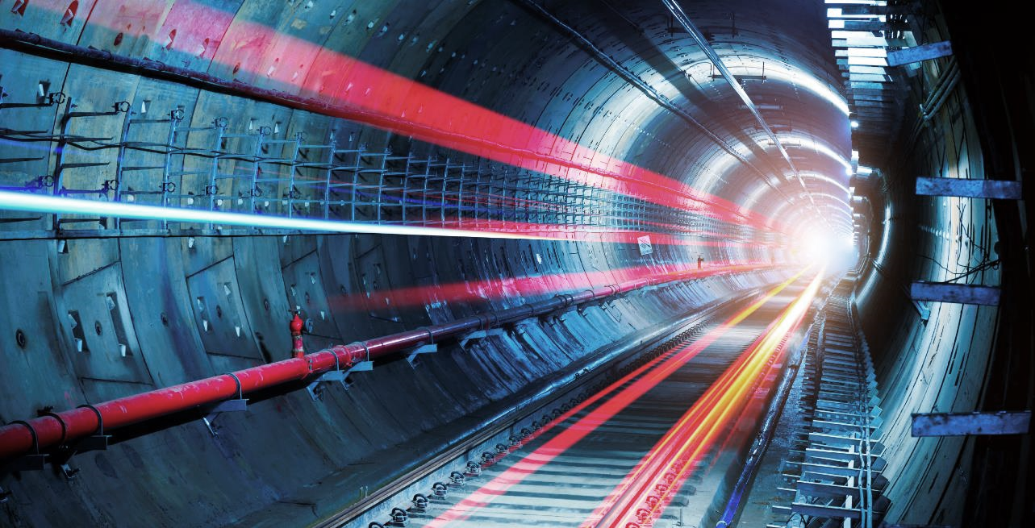
SHTANG INFRASTRUCTURE
Our skilled engineers will design and manage the construction of tunnels, roads etc.
We construct high-tech tunnels, pipe jacking , electricity, drainage channels, and lighting projects for all purposes
We will help you determine the needs; design the best solution and assemble a suitable financial package for your project.

Slide 8

OPERATION AND MAINTENANCE
The completion of a large scale project is, in most cases, the beginning of a long and fruitful relationship. We will help you operate and make the most benefit of your new project.
We will also take charge of the project maintenance and guarantee its proper function for many years.

Slide 9

SERVICES
WE PROVIDE ALL TYPE OF PROJECTS– engineering, consulting, feasibility studies, supervision, inspection, control, and more…

Slide 10

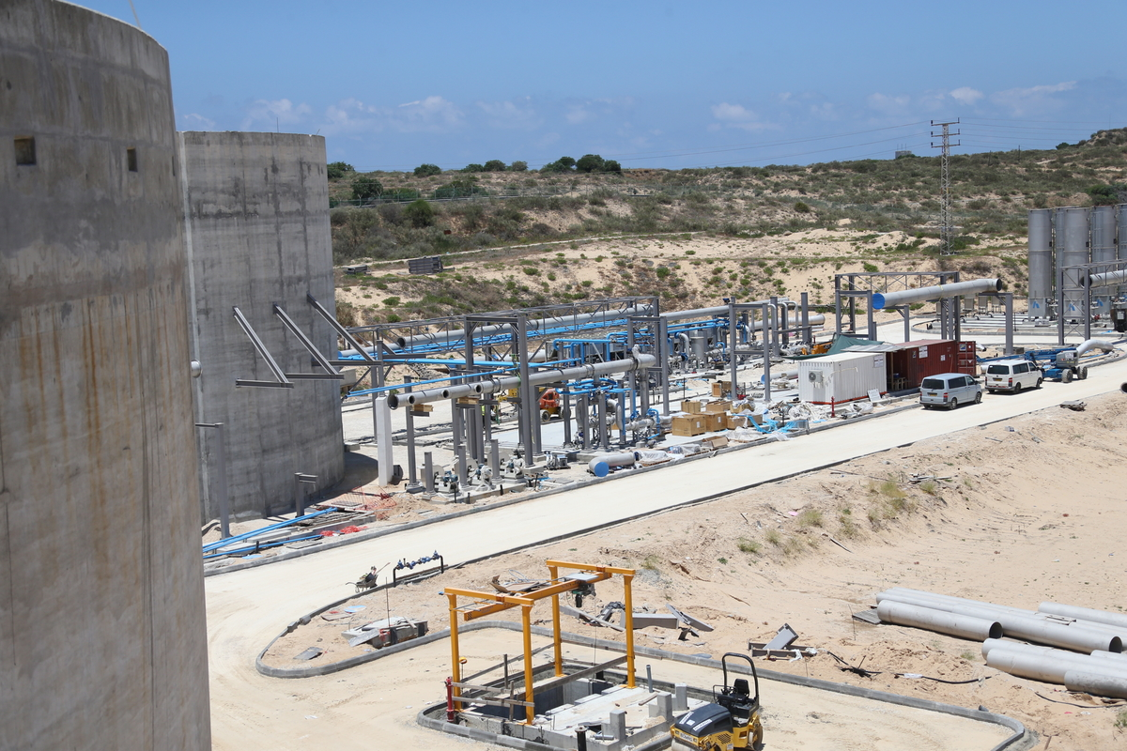
SAMPLE PROJECTS

Slide 11
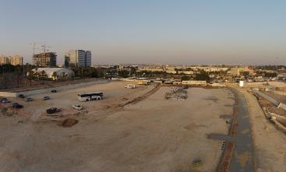
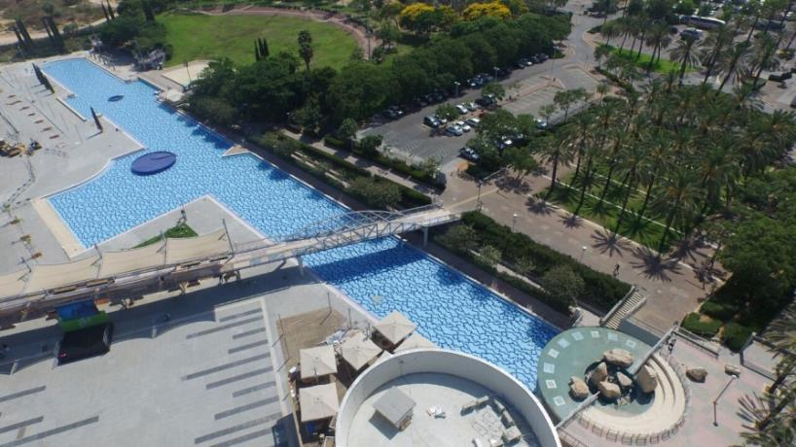
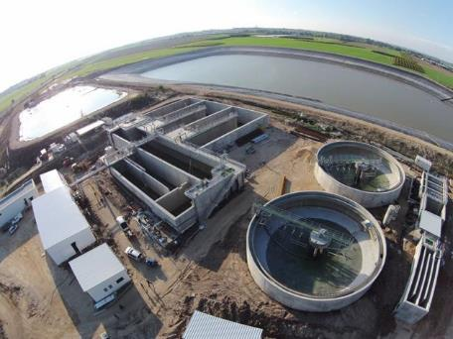

Environmental Development – Green Way
The Green Way management team supervised a multitude of workers, sub-contractors and suppliers, coordinating a finely-tuned management program and allowing for simultaneous work in a variety of tasks, e.g. dismantling, extensive earthworks, fencing, walls, drainage and water systems, sidewalks, stairs, irrigation systems, planting, and much more.
The boating canal required expert foreign workers who dismantled the old waterproof lining, renovated the concrete, the waterfall, replaced water systems and waterproofing, architectural stone covering, lighting systems, ceramic tiling with epoxy mortar, special filtering system and more.
waterproofing, underwater ceramic floor tile installation and intricate new water systems with pumps, filters, lighting and fountains.

Slide 12
NISGAV WWTP
Commissioned by: Water company Nisgav
Duration: 20 months
Capacity: 12,000 m³/d
Treatment process is based on conventional activated sludge technology. The plant treats the water to tertiary effluent quality.
The project is a DBOT that included engineering design, construction, electro mechanical installations and control, financing and operation for 25 years.

Slide 13
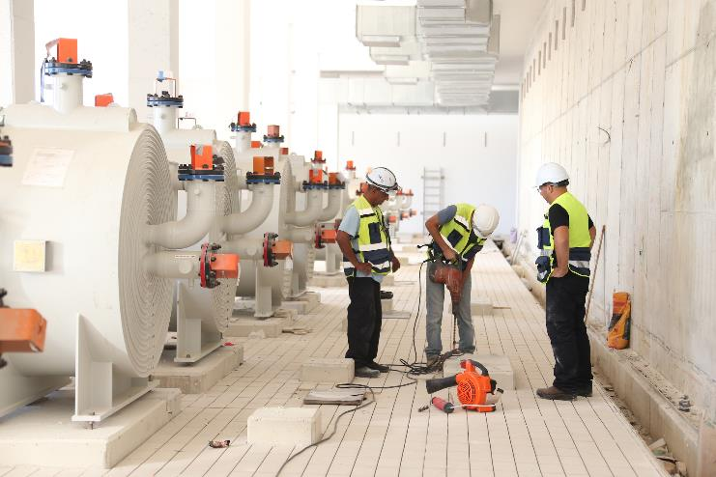

SHAFDAN RENEWABLE ENERGY PROJECT
Anaerobic Digester Facility
Commissioned by: The Dan Region Association Of Towns For Sewage Duration: 24 months
Energy Supply: 12.1 mw
The middle East’s largest green energy plant from biological processes. Using methane gas collected in the largest gas domes in the world, from the world’s largest anaerobic sludge digesters, the electricity will be sold to the Israel Electric Company.
The project includes installation and startup of equipment, piping, electrical and instrumentation & control Work.
SINCE 1935

Slide 14
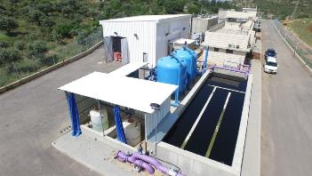
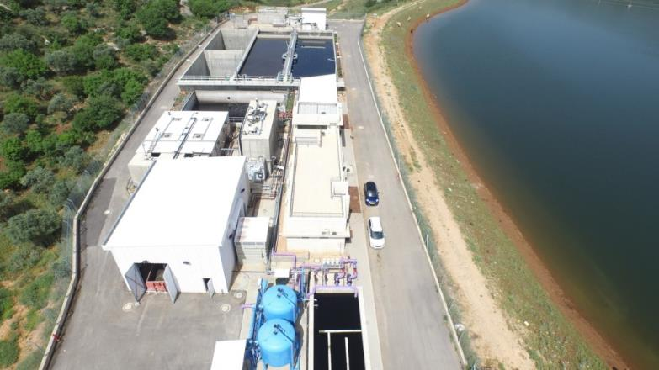

SLUDGE PROJECT
Location: Farod, Israel
Application: Municipal Wastewater
Capacity: 4,200 m3\day (1.1 MGD)
Commissioned: June 2014
Shtang constructed a complex CSBR wastewater treatment plant that ensured on demand batch treatment with uninterrupted inflow. Shtang suggested the ATAD system for sludge treatment: a method based on auto-thermophilic, aerobic digestion, which uses bacteria to digest the sludge automatically with zero chemicals and zero energy for heating. The use of the ATAD system will save significant costs to the owners of the plant, but will require professionalism and high-level maintenance and operations from Shtang for years to come.
In order to integrate the Xylem-made diffuser system with the Israel Electric Company standards and with the ATAD system, Shtang needed to make us of innovative solutions such as high-accuracy cement erections, light steel structures and various adaptations in the flow and the control systems.
In spite of the complexities of the project, which included tertiary pressure sand filters, Shtang completed all works three months ahead of schedule.

Slide 15
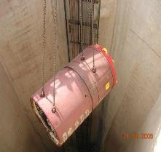
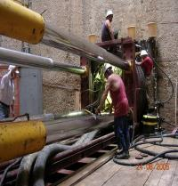
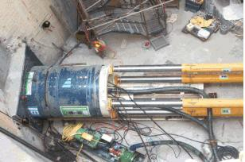
KNOWLEDGE-INTENSIVE AND HIGH-TECH TUNNELING & PIPE JACKING
More than 15,000 meters of Pipe Jacking (DIA from 1.2 to 4.5m)
The eastern sewage collector in Israel pressure line Crossings of Highway No. #1 and the fast train to the airport.

Slide 16
TURN-KEY
SHTANG will provide you with full operational turnkey projects
We are a team of contractors and project leaders who will
deliver complex and demanding projects to the highest technological standards
We will also provide consulting and maintenance services for the entire project life span

Slide 17
FINANCING
SHTANG can provide financial solutions for any turn-key project.
We have the experience, knowhow and connections enabling us to offer an attractive finance package for our clients .
We have excellent relationships with the biggest international banks active in project/structure financing – HSBC, ING , Deutsche Bank , BNP Paribas , Banco Santander , Bank Hapoalim , Bank Leumi, Bank Discount and more.
We have an excellent relationship with the leading ECA’s (Export Credit Agency) and private insurers in the world – Ashra, Atradius, Euler Hermes, COFACE, EXIM, ECGD UK, NEXI Japan, ZURICH and more.
We have been involved in financing projects worth more than 1 Billion Dollars.
SHTANG is a financially robust group , privately held by strong shareholders ; no debt , strong equity and excellent financial ratios.

Slide 18
PROJECT FINANCE GENERIC MODEL
Buyer
Commercial Agreement
Advanced Payment (15%)
Financial Agreement (Short Term)
seller
Commercial Bank
Borrower
Main Loan (85%)
Financial Agreement (Long Term)
Political Risk Insurer
(E.C.A, Private)

Slide 19
WHY US
ON
TIME
ON BUDGET
ON QUALITY
FINANCING
RESEARCH AND PLANNING
RESPONSIBILITY
TECHNOLOGY AND KNOWHOW
RECORD OF SUCCESS
THOUSANDS OF SATISFIED CLIENTS SINCE 1935
MAN POWER
SERVICE
FLEXIBILITY
RELIABLITY

Slide 20
CODE OF ETHICS
WE BELIEVE THE END DOES NOT ALWAYS JUSTIFY THE MEANS.
IN THIS RESPECT, WE HOLD OURSELVES TO A HIGH ETHICAL STANDARD OF HONESTY, RESPONSIBILITY AND RESPECT
To serve our clients with honesty
We will only accept assignments for which we are qualified
We will not discriminate
We will obey laws and regulations
We will endeavor to avoid conflicts of interest
We will only make statements that are truthful
We will continue to develop our professional knowledge and competency
Our employment terms are all according to state law
We favor women employment
We welcome disabled employees

Slide 21
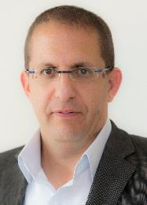
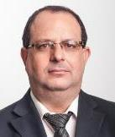
MANAGING TEAM – SHTANG INTERNATIONAL
ITAY GRINSPAN
CHAIRMAN
Itay has over 15 years of experience in various financial positions in both private and publicly owned companies
STEVEN SENTER
PRESIDENT & CEO
Steven filled key positions in global leading companies for 20 years. He is an expert in financing and managing large and complex projects worldwide
.

Slide 22
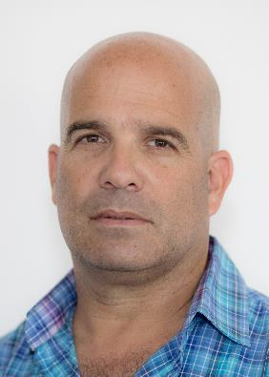
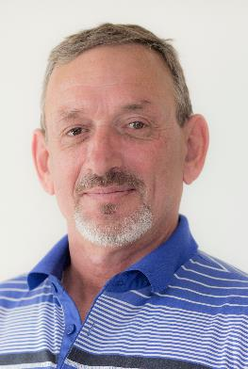
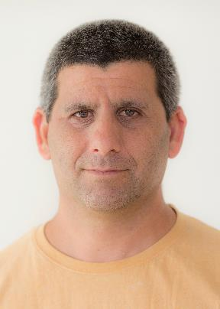
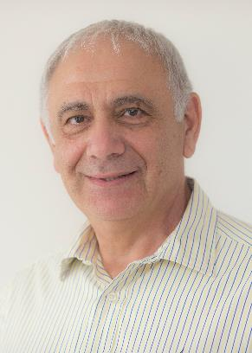
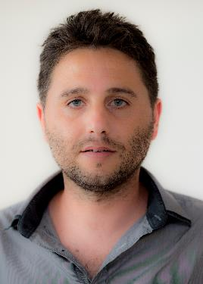
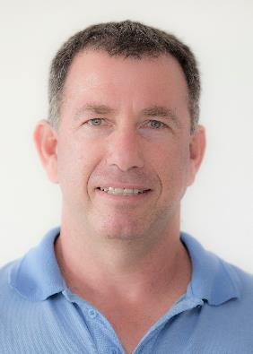
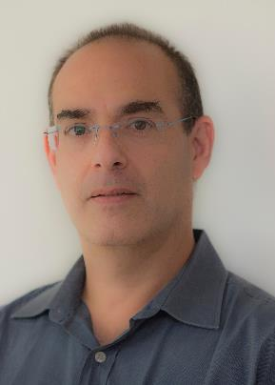
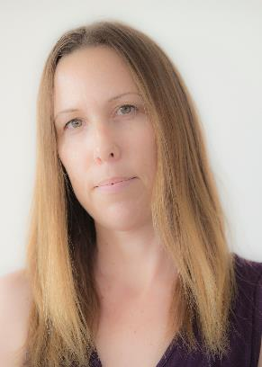
OUR TEAM

Slide 23
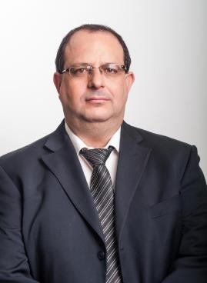
STEVEN SENTER CEO – SHTANG INTERNATIONAL
Managed dozens of infrastructure project in more than 20 countries
Vast experience in the fields of water ,energy and security
CPA & BA in Economy and Business Management
Extensive international experience – mostly in Africa, Asia and Latin America
Extensive international financing experience in structured finance & project finance - raised Over 1 billion $ for projects all over the globe
Business oriented – M&A and Business Development
Hebrew, English , Spanish – Excellent – Mother tongue level

Slide 24
THANK YOU

